Slide 1
Promising Practices Made Easy: The 21st Century CLC Illinois Benchmarking Web Tool presented to: Illinois 21st CCLC 2010 Spring Conference Hilton - Oak Lawn, IL April 13, 2010
Harvey Smith
Northern Illinois University
Penny Billman
University of Illinois College of Medicine -Rockford
Notes:
Add a picture to this slide.

Slide 2
Promising Practices Benchmarking Tool
A web tool that…
Allows you to access the catalog of information about 21st CCLC grants in Illinois
Compares your grant with other programs using comparison yardsticks that you select
Features information that you and other grantees have submitted as part of evaluation process – presented anonymously
Is convenient, quick, easy to use (no, really!)
Provides student data portal for PPICS reporting

Slide 3
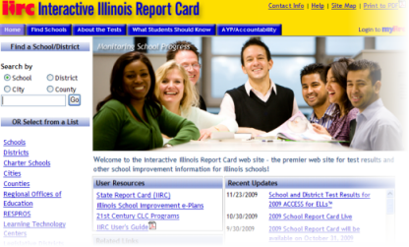
Promising Practices Benchmarking Tool
Two ways to access the web tool
Go to http://www.il21cclc.niu.edu
Or from IIRC at http://iirc.niu.edu, click on the link to the web site right on
the homepage, under
“Resources”

Slide 4
Logging into the Benchmarking Tool

Slide 5
Benchmarking Tool Homepage – Access to All Features

Slide 6
Step 1 - Selecting Search Criteria

Slide 7
Step 2 – Performance Indicators

Slide 8
Step 2 – Performance Indicators

Slide 9
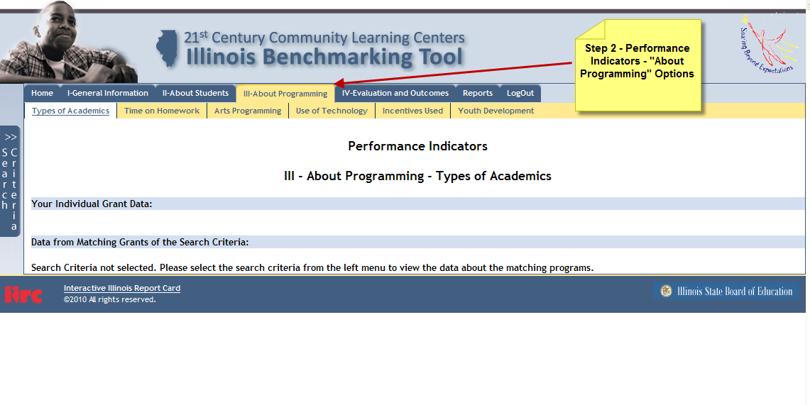
Step 2 – Performance Indicators

Slide 10
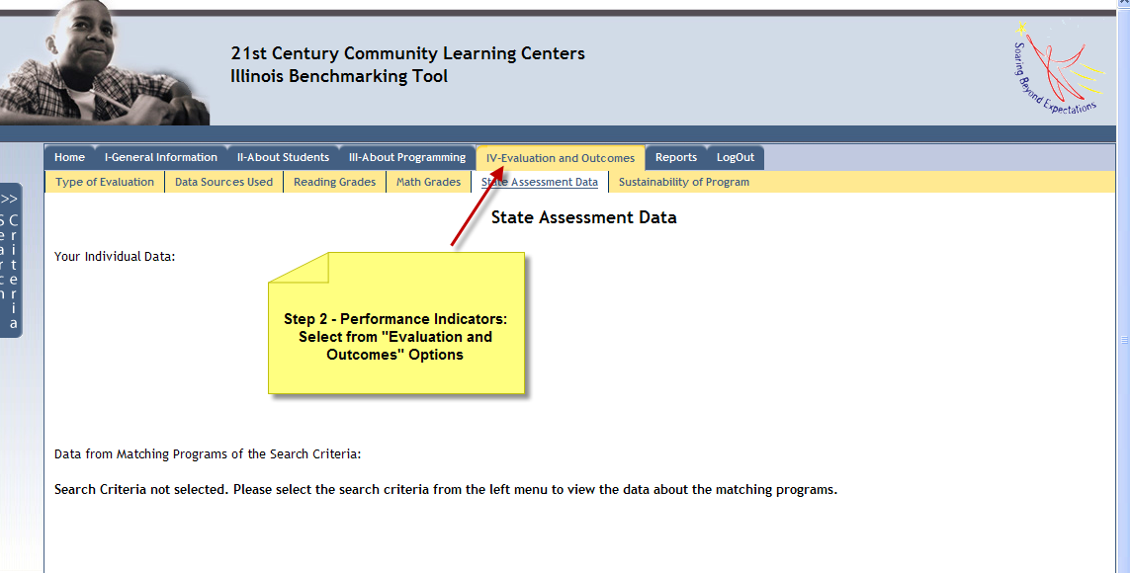
Step 2 – Performance Indicators

Slide 11
Information Results

Slide 12
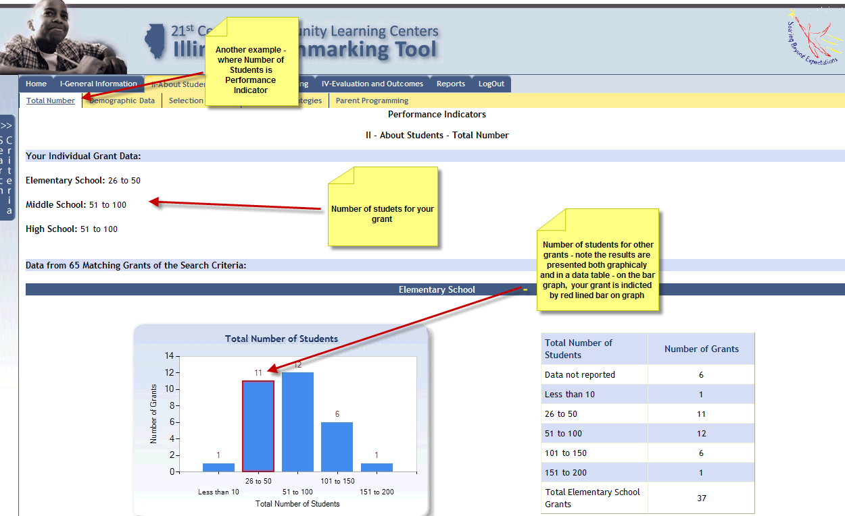
Information Results

Slide 13
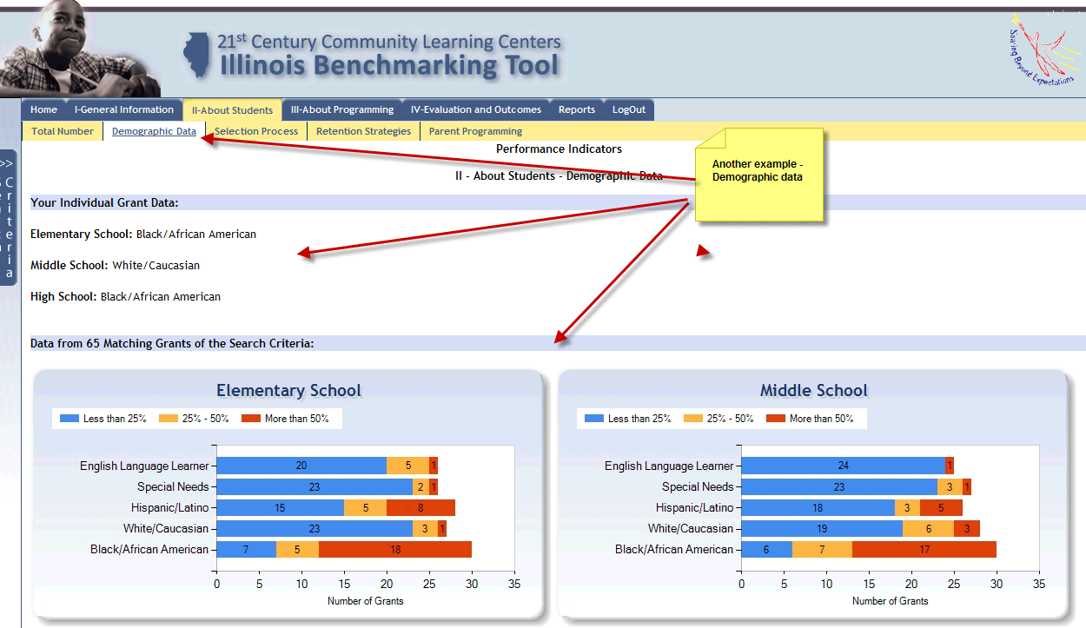
Information Results

Slide 14
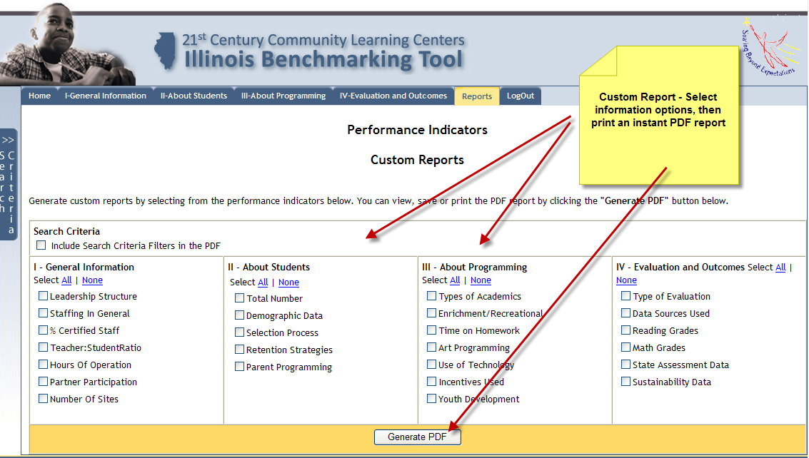
Custom Reports Feature - Evaluation Feedback

Slide 15
Student Data Portal

Slide 16
Your Student Data Roster

Slide 17
Thank You!
Contacts:
Student data reporting feature:
Dr. Harvey Smith - Northern Illinois University
815-753-0978 or hsmith@niu.edu
For other questions or technical assistance with web tool:
Valerie Lorusso – NIU – 815-753-0978 or vlorusso@niu.edu
For Statewide 21st CCLC Program Evaluation:
Dr. Penny Billman – University of Illinois-College of Medicine Rockford
815-395-5783 or pbillman@uic.edu

